Slide 1
Bar Sales Prediction
Overview and Next Steps
Confidential, for internal use only

Slide 2
Services/ Resources used
AWS Components
User Interface: Cognito, Serverless.
Machine Learning: Sagemaker
Data Storage: S3, DynamoDB
Content Delivery: API Gateway
Customer Components
Initial Training Data from 101 bars in Toronto, Canada

Slide 3
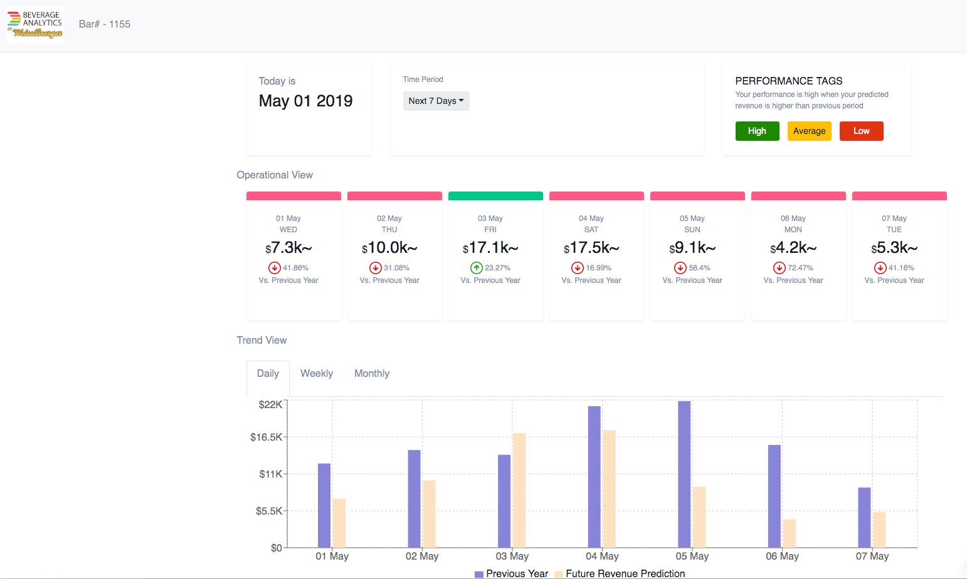

Slide 4










Application Architecture
AWS Cloud
Amazon
API Gateway
Lambda
Amazon SageMaker
Amazon Cognito
S3
Amazon DynamoDB
Parameter store
Website
S3
Batch Upload of Training Images
Lambda
Onboard new Cities
Amazon
API Gateway
AWS Step Functions

Slide 5

Machine Learning Approaches
First approach: Recurrent Neural Networks (RNN).
Used to perform temporal projections if data is clearly tagged with dates.
Second approach: Regression Methods.
Alternative if RNN is not working and there are other features available (weather, events etc).
x
Third approach: Genetic Algorithm.
Alternative if first and second approach are not working and there are other features available (weather, events etc).

Slide 6
Data status
Data from 101 bars in Toronto are available from around 2016 to 2019.
Data was aggregated from transaction level to daily.
Data is recorded at different periods of time for each bar.
Number of days that data is recorded for each bar is also different.
There are a lot of gaps in the data (days with missing data) for many bars.
36 bar out of 101 had adequate data for the analysis.
Data filtered to 2017/11/01 - 2019/03/04 interval.

Slide 7
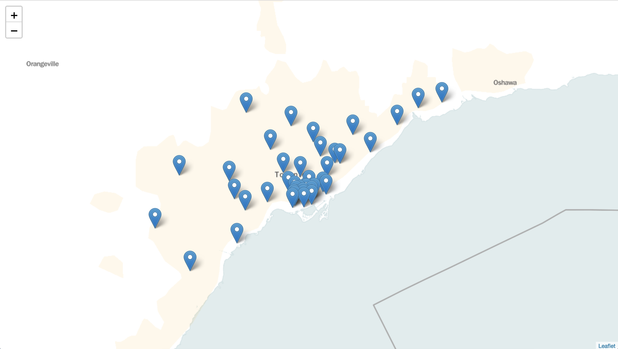
36 Bars map
Toronto

Slide 8
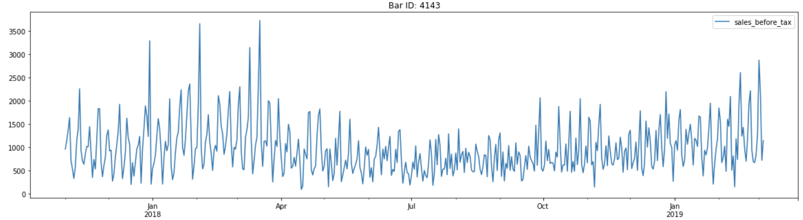
Sample data for 1 bar after (aggregation)
Daily Sales ($)

Slide 9
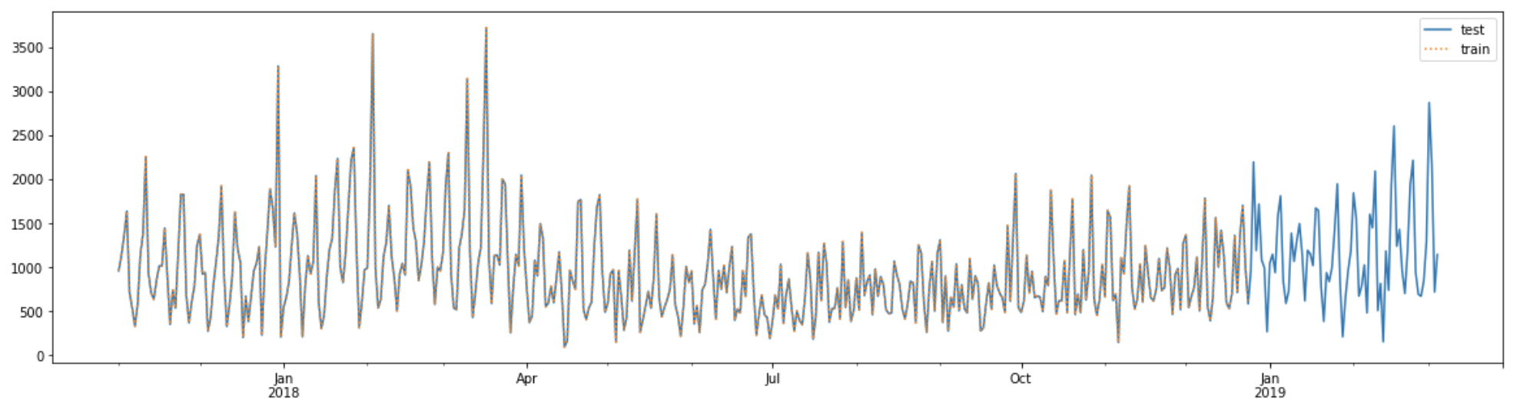
First approach: Recurrent Neural Networks (RNN).
Used ” sales_before_tax” for 36 bars to train an RNN:

Slide 10
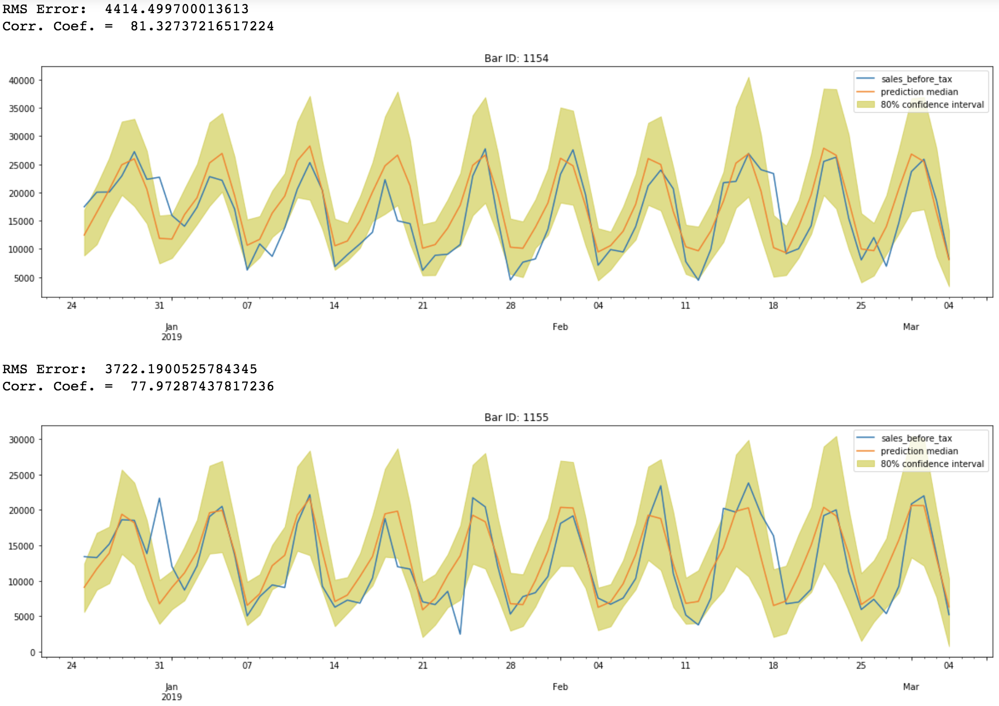
Recurrent Neural Networks- Prediction results

Slide 11
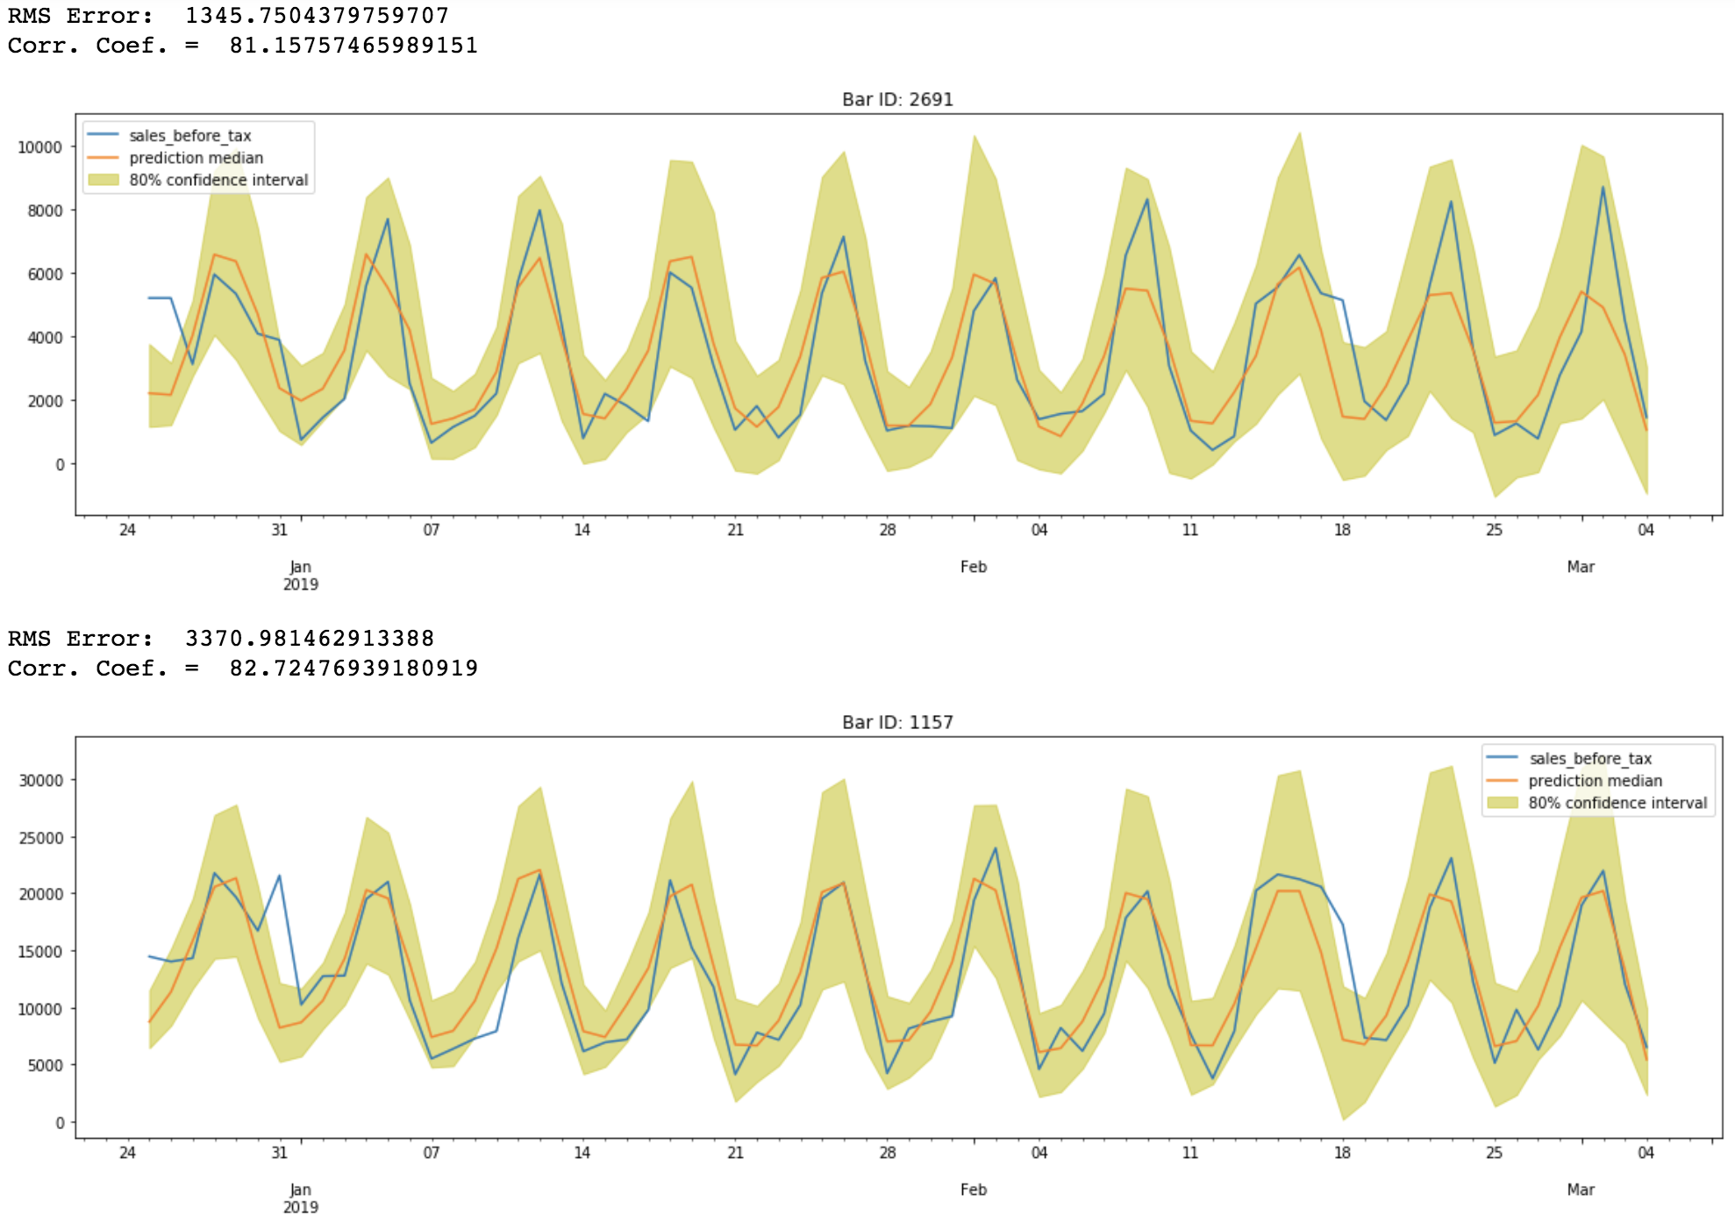
Recurrent Neural Networks- Prediction results

Slide 12
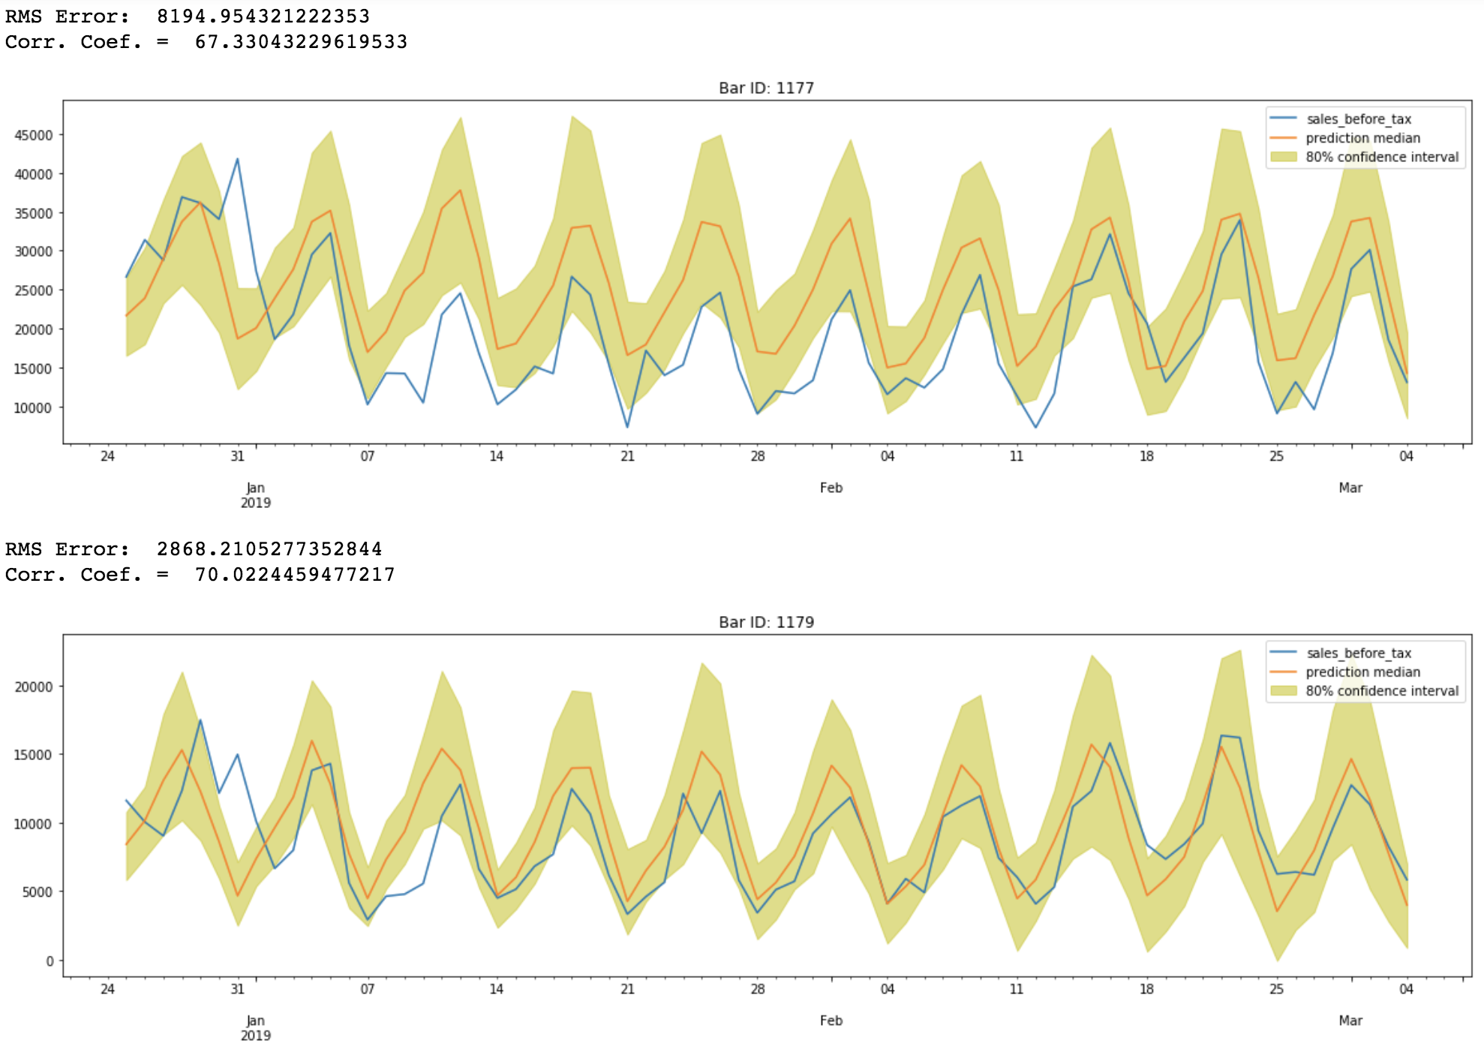
Recurrent Neural Networks- Prediction results

Slide 13
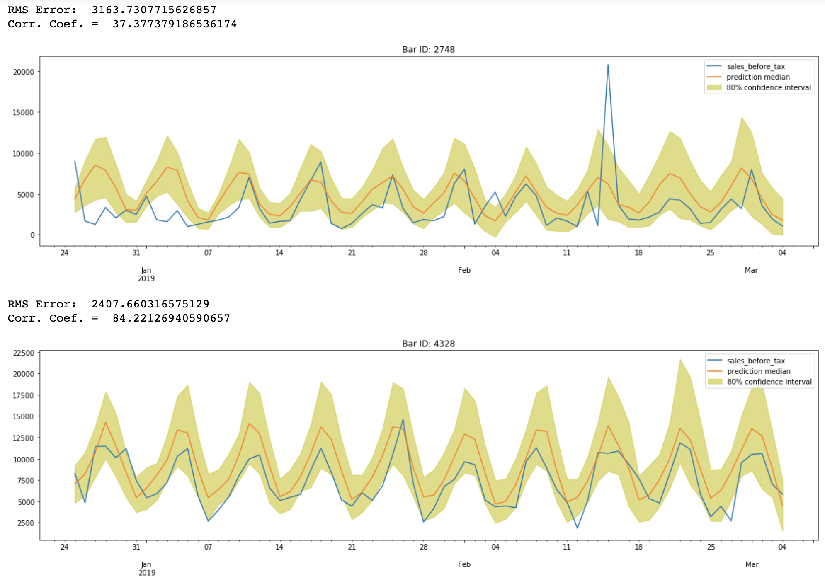
Recurrent Neural Networks- Prediction results

Slide 14
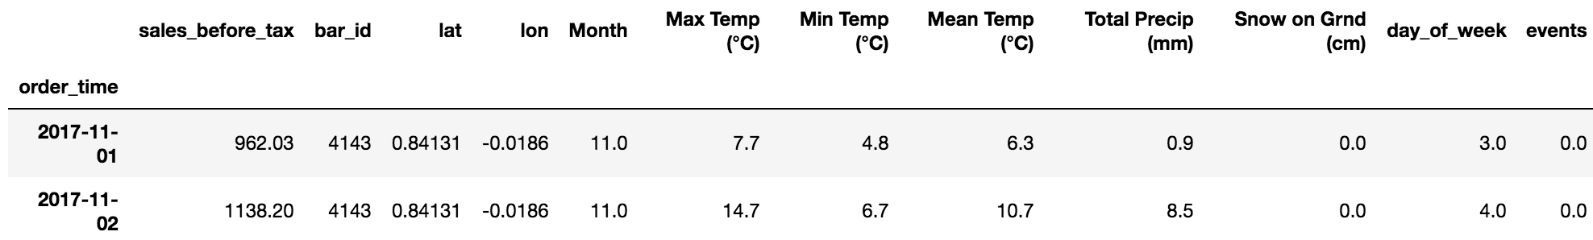
Second approach: Regression
Used other data types to create a regression mode for predicting ”sales_before_tax”
For events, only national holidays information was available.

Slide 15
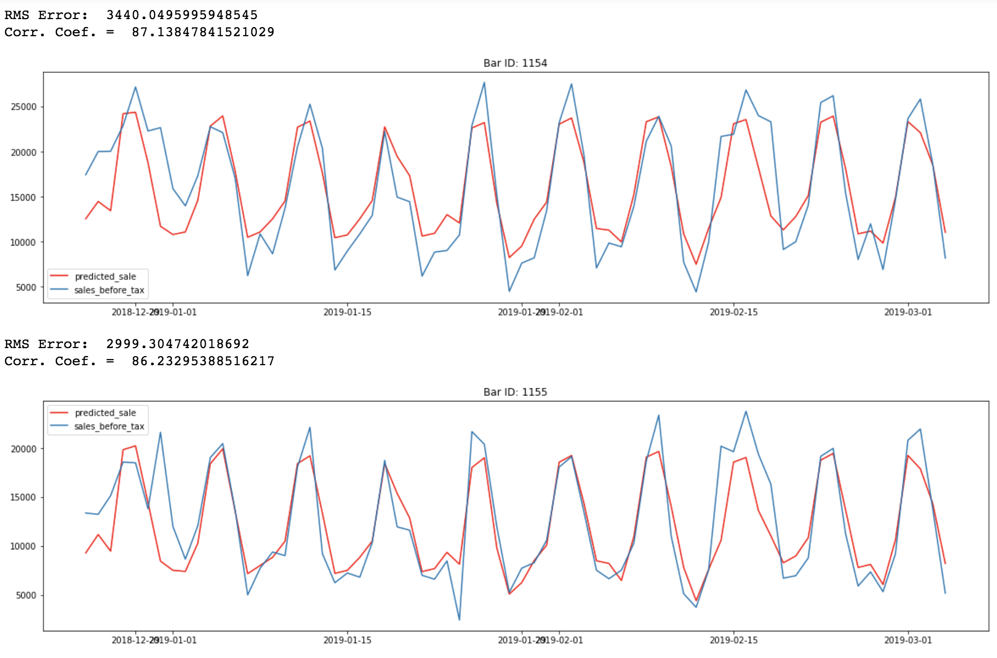
Second approach results

Slide 16
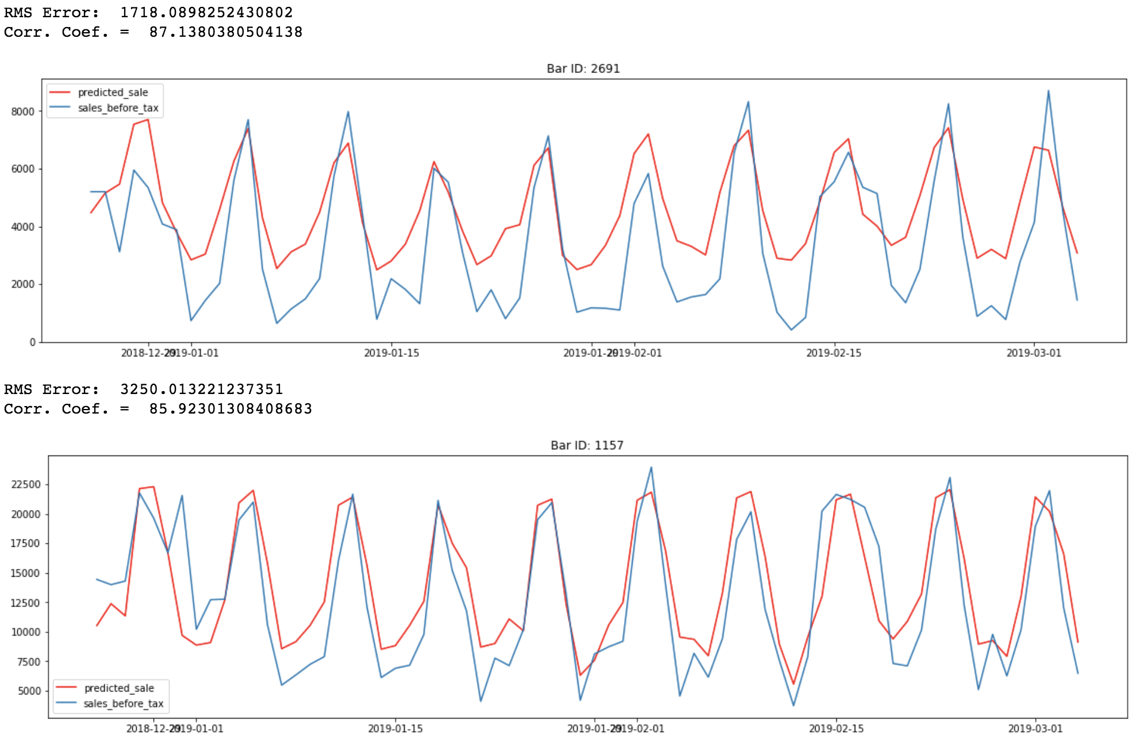
Second approach results

Slide 17
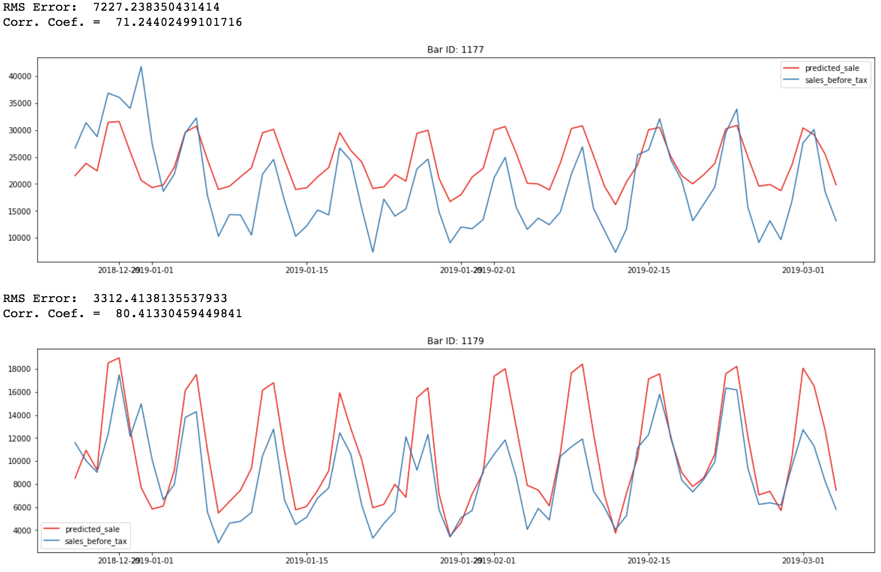
Second approach results

Slide 18
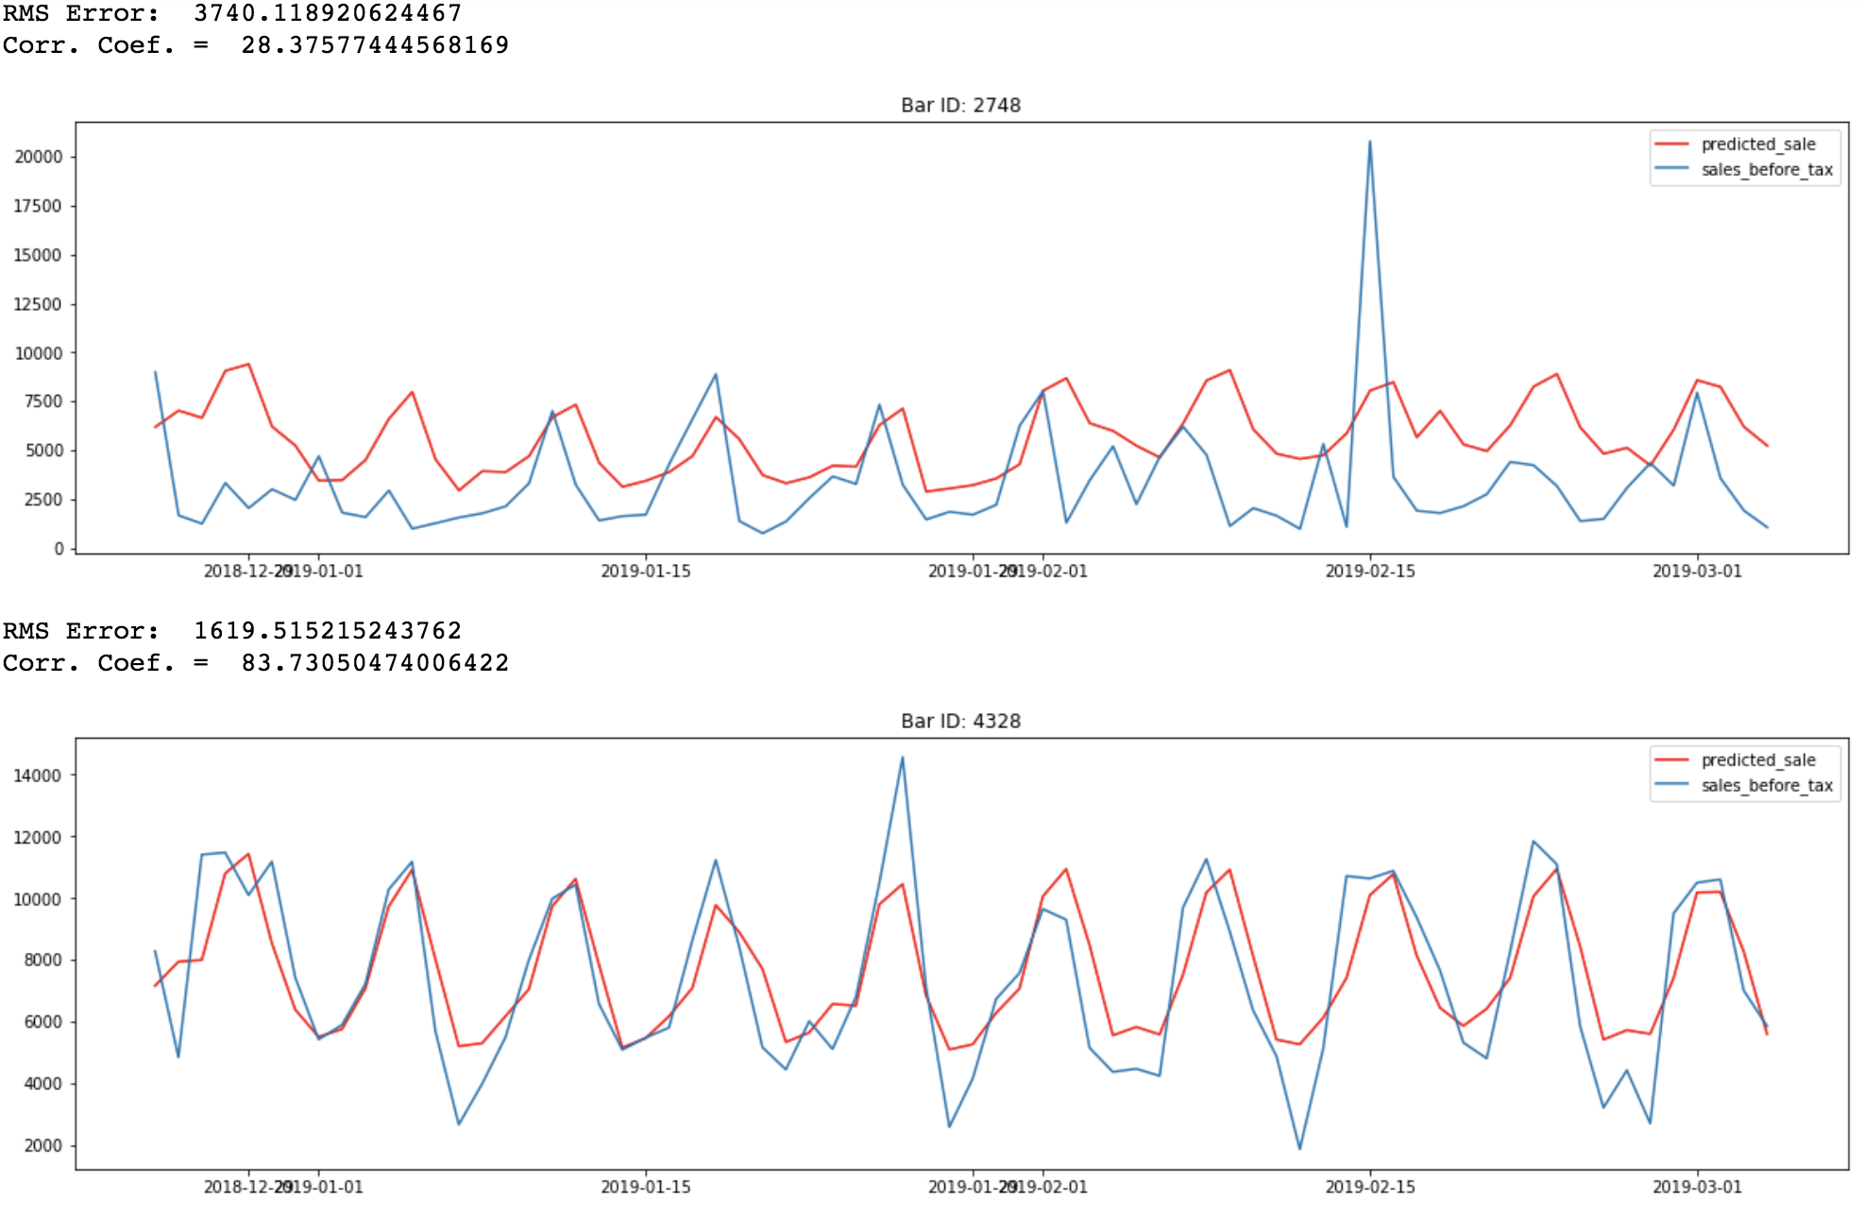
Second approach results

Slide 19
Comparison of RNN to Regression methods
RNN
Advantages:
Requires only historical sales data
Does not require data preparation to do prediction into future
Disadvantage:
If other types of data are available, we cannot use them
Requires continuous historical data for new bars to make predictions
Regression
Advantages:
Is not affected by gaps in the data, or start/stop time of recording.
Allows using of different sources of data.
Does not require historical data for new bars to make a prediction.
Can predict sales for new bar locations.
Disadvantage:
If other types of data are not available, accuracies will be lower

Slide 20
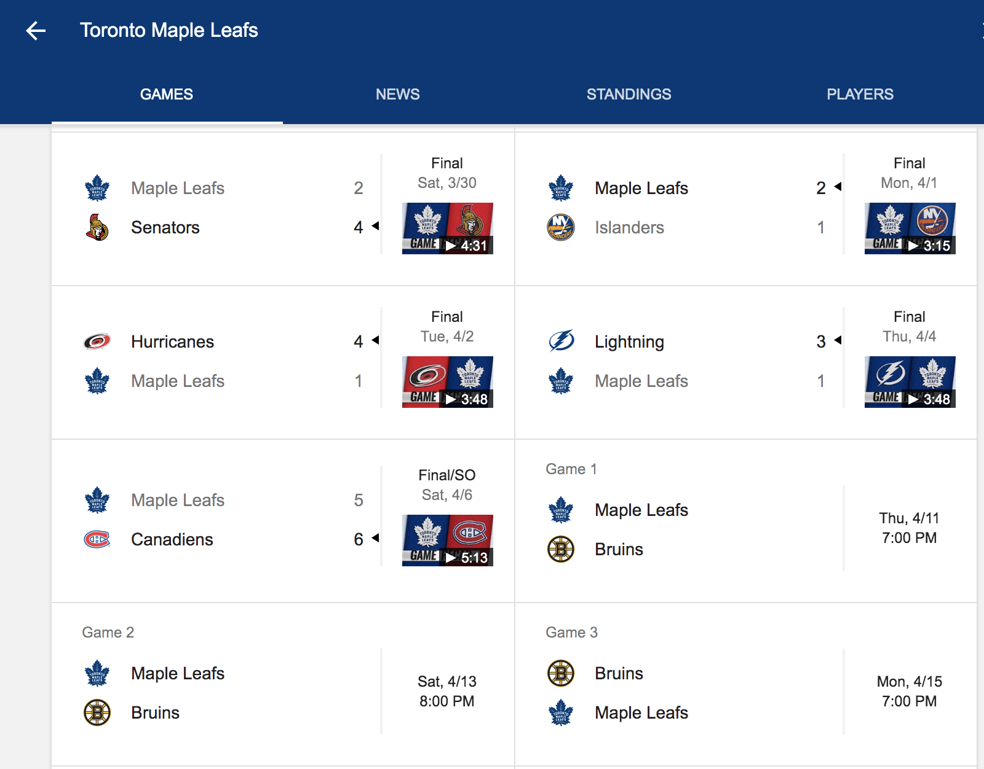
New events data added (Maple Leaf games 2018-2019)

Slide 21
Feature Importance (based on RMS Error)
Features | RMSE ($)
latitude | 5278
longitude, Day-of-week | 4531
longitude, Day-of-week, Month | 4077
longitude, Day-of-week, latitude, Month | 4005
longitude, Day-of-week, latitude, Month, Mean Temp | 3981
longitude, Day-of-week, latitude, Month, Mean Temp, % Rain | 3968
longitude, Day-of-week, latitude, Month, Max Temp, % Rain, % Snow | 3915
longitude, Day-of-week, latitude, Month, Max Temp, % Rain, % Snow, Events | 3915

Slide 22
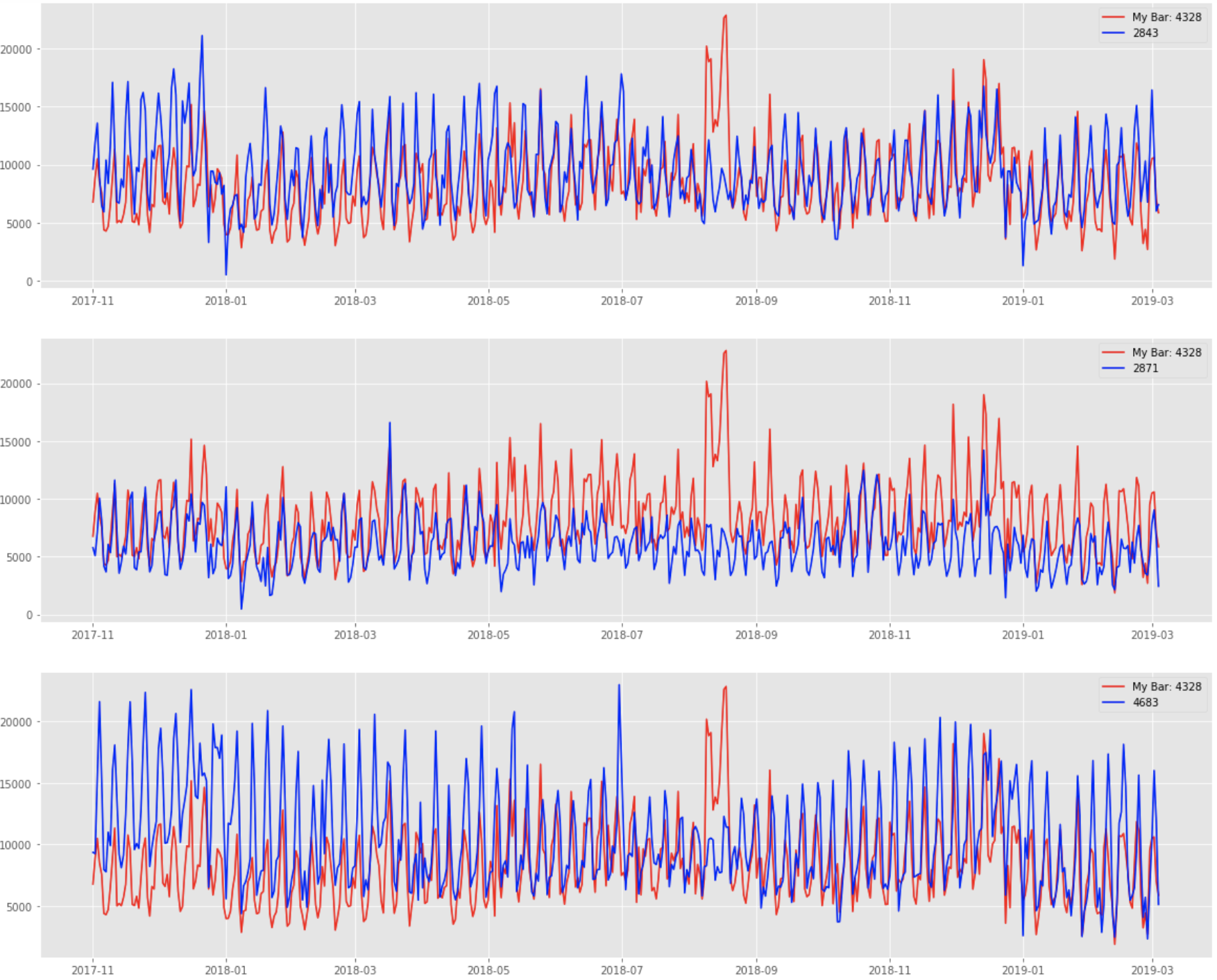
Bars Like You (based on RMS Error)
Most similar

Slide 23
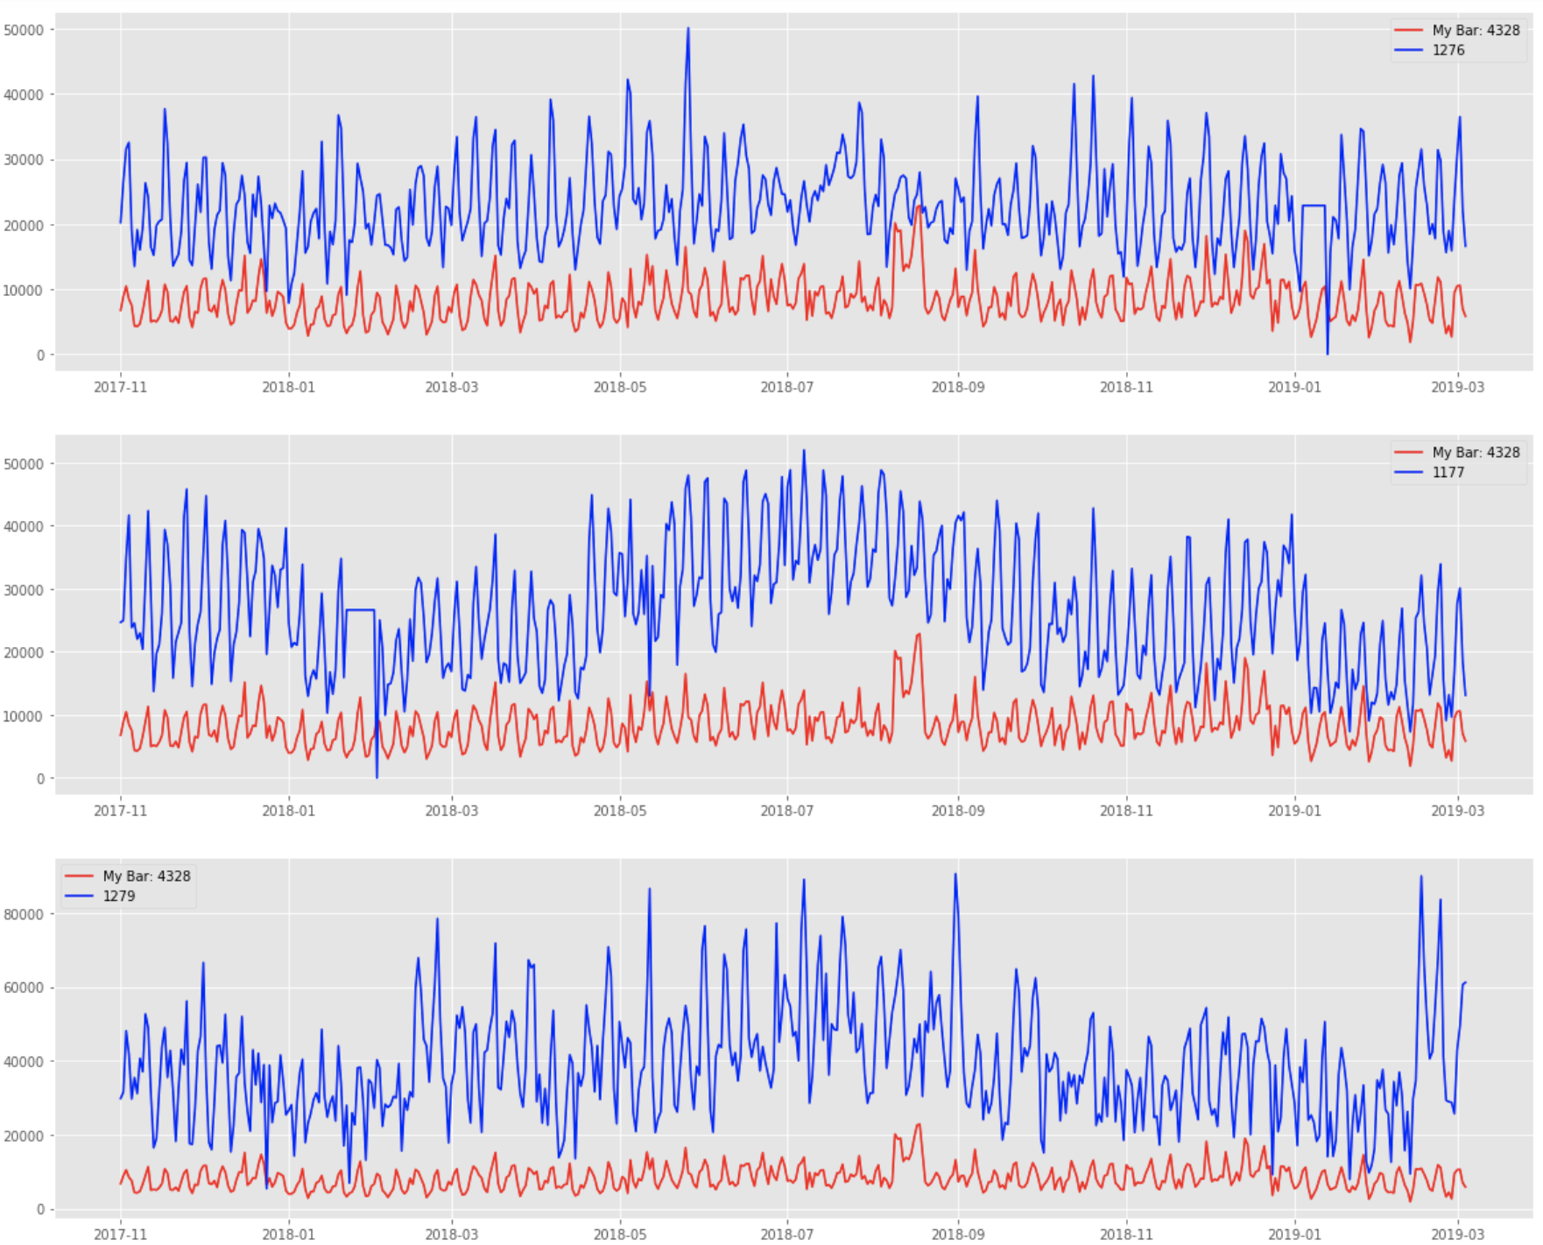
Bars Like You (based on RMS Error)
Least similar

Slide 24
Data Constraints and Recommendations
Limited amount of data (RNN, a deep learning approach, requires a lot of data to build accurate models.)
Data from more bars can improve the accuracies.
Longer time span for data from each bar (more annual cycles in data to capture general trend and increase overall accuracy)
Currently there is only 1 annual cycle in the data.
Detailed and comprehensive events data
Currently data for promotions, happy hour and most of the sports events are not present in the data. Also events can be given weights according to their importance.

Slide 25
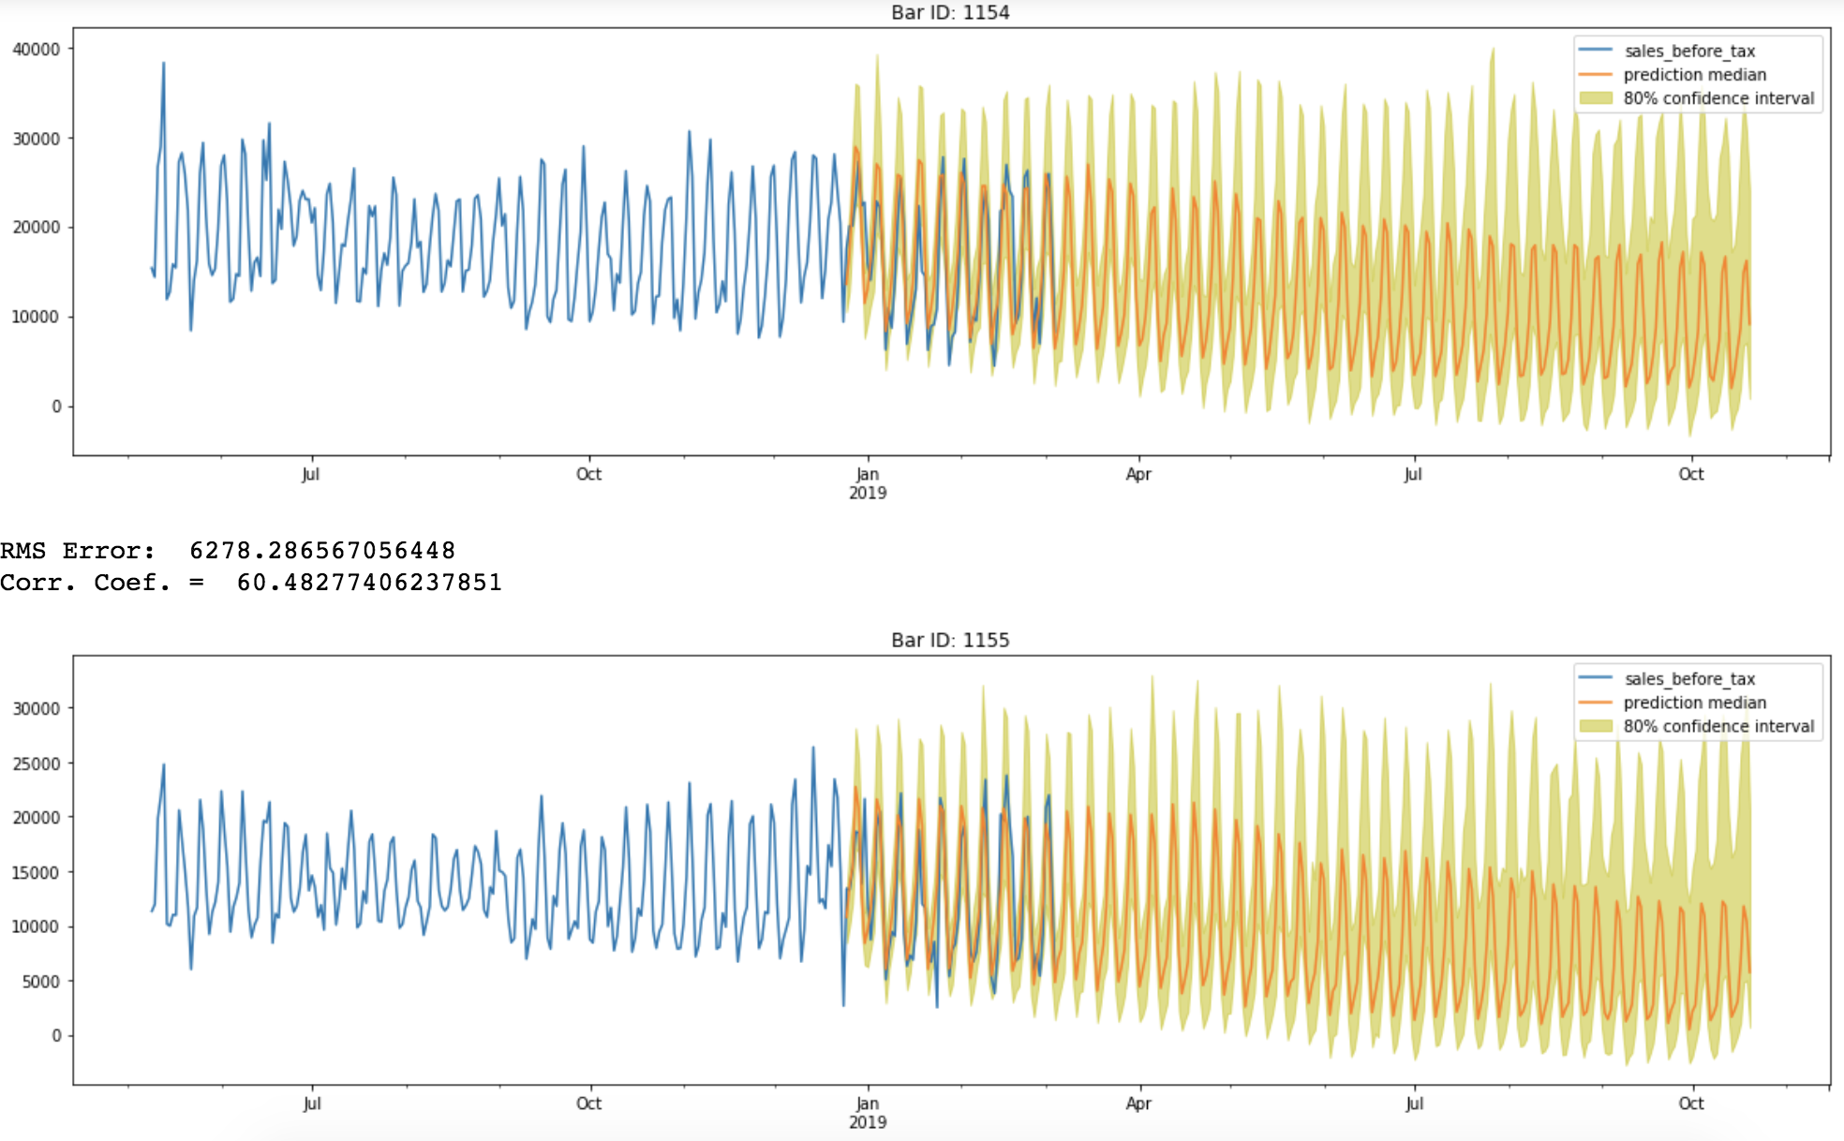
Recurrent Neural Networks- Real Future Prediction

Slide 26
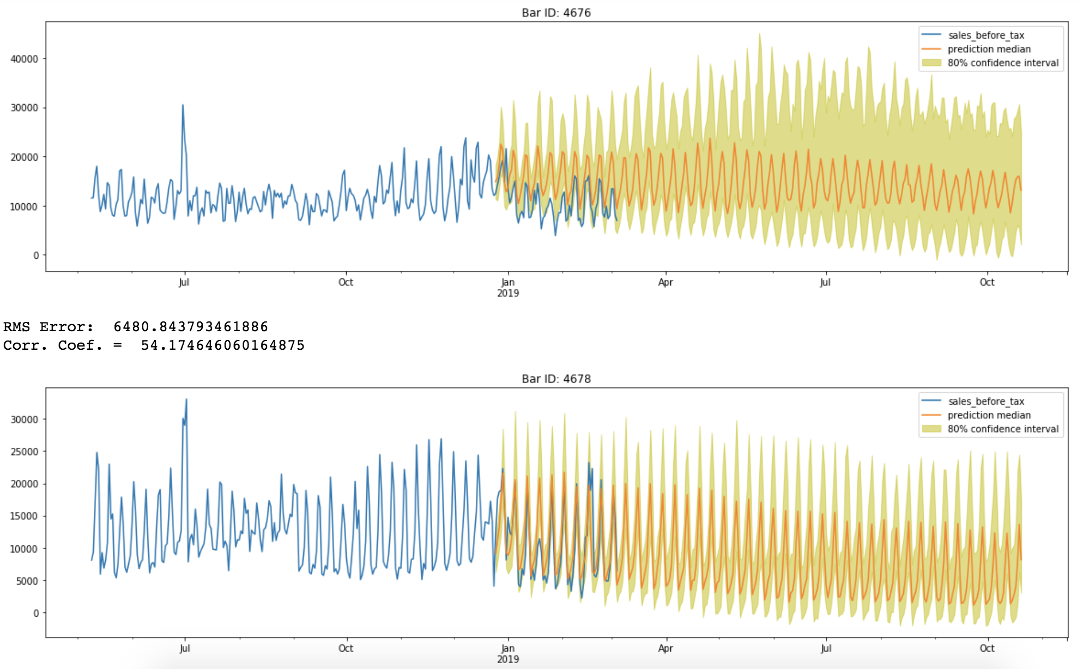
Recurrent Neural Networks- Real Future Prediction

Slide 27
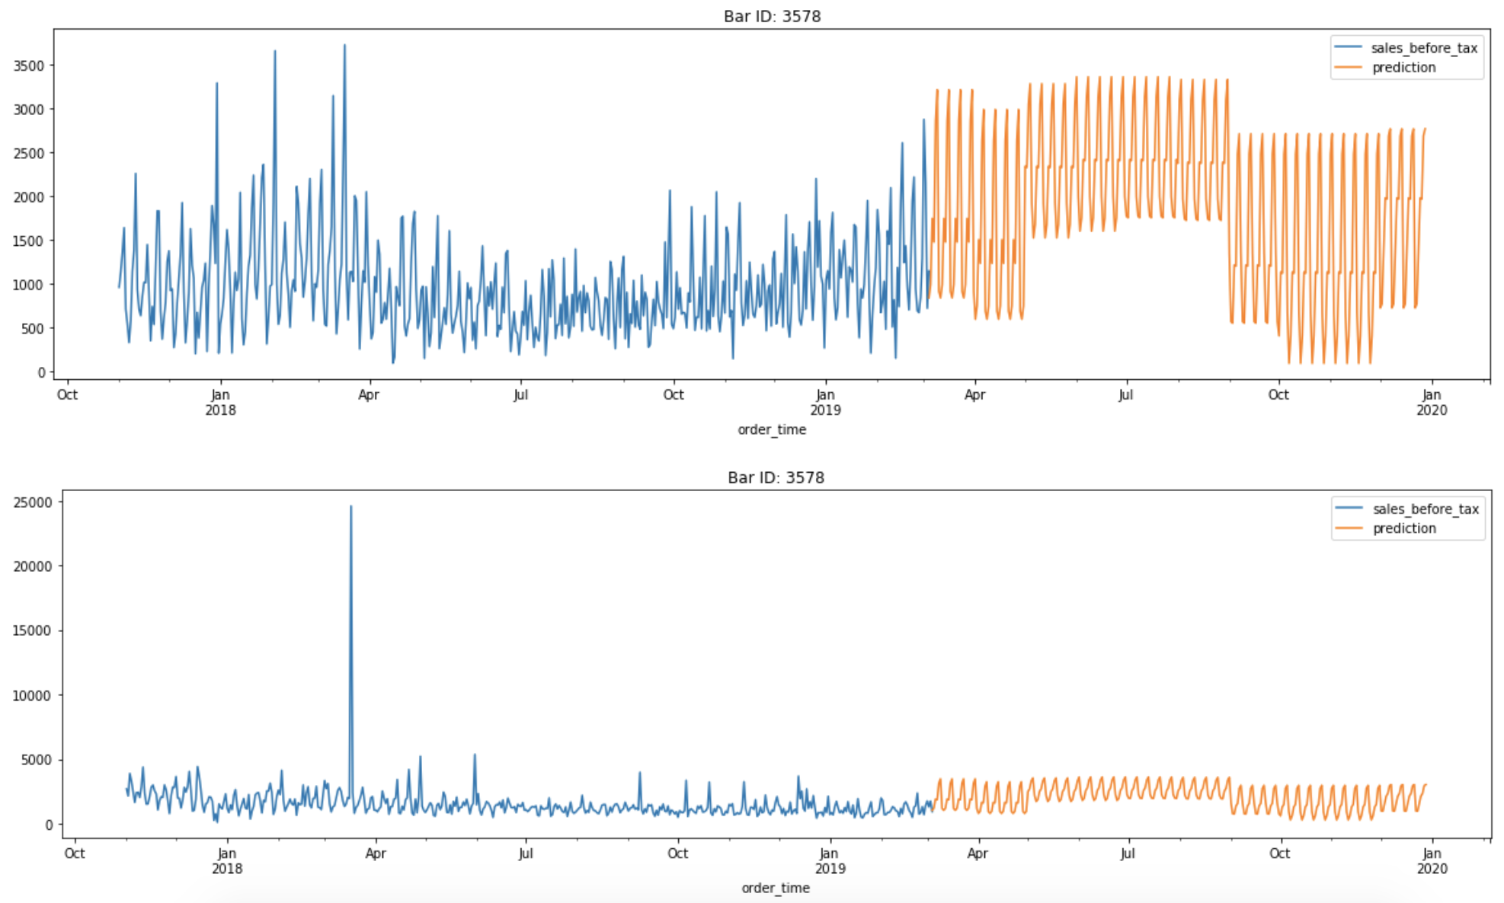
Regression- Real Future Prediction
longitude, Day-of-week, latitude, Month

Slide 28
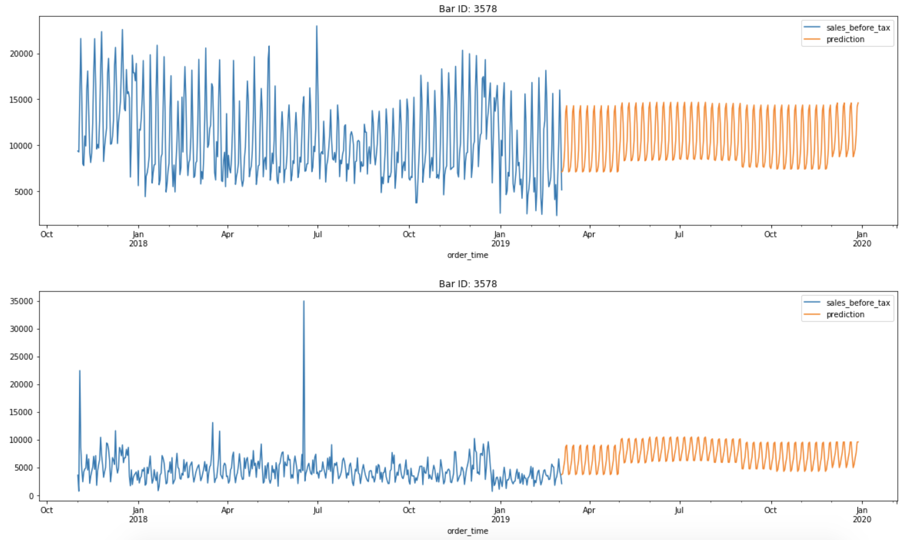
Regression- Real Future Prediction

Slide 29
What’s Next?

Slide 30

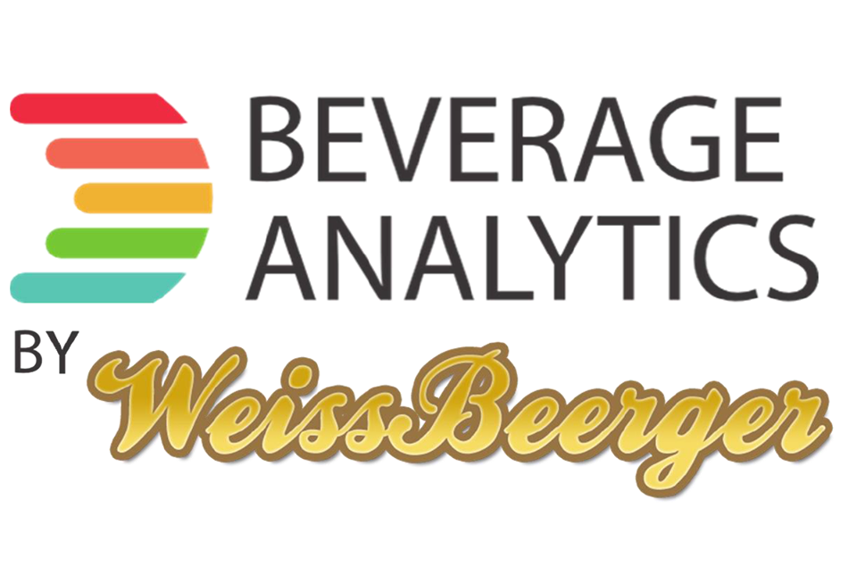
Transfer knowledge from the AWS developers to Weissbeerger developers so they are able to continue work to take the prototype to production.
Decide if further feature development or a broader field test makes the most sense going forward.

Slide 31
Path to Production
Improve ML models accuracy by using more data.
Strengthen security posture.
Configure WAF at Cloudfront and consider AWS Shield for DDOS mitigation.
Encrypt data at S3, DynamoDB and other data stores as required.
Implement Authorization both at UI and API layers.
Scale up deployment
Develop CloudFormation for the complete structure.
Global deployment

Slide 32
Feedback: New Features?

Slide 33

Need Help?
AWS professional services long-term consulting services to help with any AWS project.
AWS certifies specialist partners ensuring they’re well qualified to help with any AWS project.
https://aws.amazon.com/professional-services/
https://aws.amazon.com/partners/

